Slide 1
Neural Network and fuzzy control Project review 3
BY-
SHASHANK SRIDHAR 19BCE1429
Shrisrinivas P 19BEE1055
Kamal Kant Yadav 19BEE1149
TANYA 19BEE1199

Slide 2
OBJECT DETECTION USING MACHINE LEARNING

Slide 3
PROBLEM STATEMENT
Object detection is the task of detecting instances of objects of a certain class within an image. Achieving new heights in object detection and image classification was made possible because of Convolution Neural Network(CNN). However, compared to image classification the object detection tasks are more difficult to analyse, more energy consuming and computation intensive. To overcome these challenges, a novel approach is developed for real time object detection applications to improve the accuracy and energy efficiency of the detection process. This is achieved by integrating the Convolutional Neural Networks (CNN) with SSD mobilenet. Object detection has applications in many areas of computer vision, including image retrieval and video surveillance.

Slide 4
TYPE OF NEURAL NETWORK USED
SSD (Single Shot MultiBox Detector) is a popular algorithm in object detection. It’s generally faster than Faster RCNN. The SSD architecture is a single convolution network that learns to predict bounding box locations and classify these locations in one pass. Hence, SSD can be trained end-to-end. By using SSD, we only need to take one single shot to detect multiple objects within the image.

Slide 5
Software used
We are using python-open cv and anaconda prompt, for implementing our project.

Slide 6
Object Detection using SSD Mobilenet and Tensorflow Object Detection API : Can detect any single class from coco dataset.
SSD (Single Shot MultiBox Detector) is a popular algorithm in object detection. It’s generally faster than Faster RCNN. In this post, I will give you a brief about what is object detection, what is the idea behind neural networks and specifically how SSD architecture works. Then we implement SSD MobilenetV2 trained over COCO dataset using Python idle. In this project we can detect any single class from the classes provided by COCO dataset.

Slide 7
What is Object Detection?
Object detection is a computer technology related to computer vision and image processing that deals with detecting instances of semantic objects of a certain class (such as humans, buildings, or cars) in digital images and videos. Well-researched domains of object detection include face detection and Pedestrian Detection. Object detection has applications in many areas of computer vision, including image retrieval and video surveillance.
Object detection as the term suggest is the procedure to detect the objects in real world. For example, dog,car,humans, birds etc. In this process we can detect the presence of any still object with much ease. another great thing that can be done with it is that detection of multiple objects in a single frame can be done easily. For Example, in the image below the SSD model has detected mobile phone, laptop, coffee, glasses in a single shot. It detects different objects in a single shot.

Slide 8
SSD Mobile Net Architecture
The SSD architecture is a single convolution network that learns to predict bounding box locations and classify these locations in one pass. Hence, SSD can be trained end-to-end. The SSD network consists of base architecture (MobileNet in this case) followed by several convolution layers:
By using SSD, we only need to take one single shot to detect multiple objects within the image, while regional proposal network (RPN) based approaches such as R-CNN series that need two shots, one for generating region proposals, one for detecting the object of each proposal. Thus, SSD is much faster compared with two-shot RPN-based approaches.

Slide 9
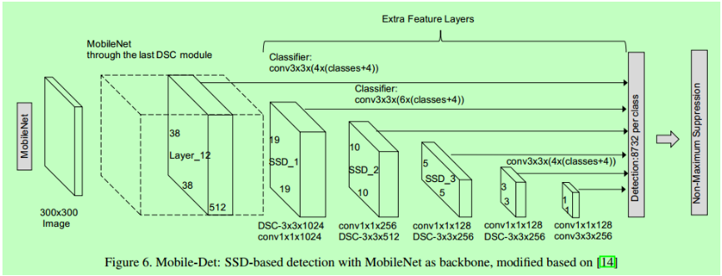

Slide 10
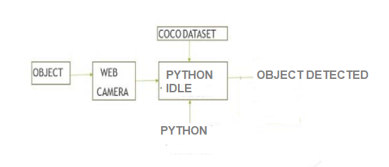
Block diagram

Slide 11
Work Progress
We have applied the same technique to our own customized dataset which could detect object of our own choice and gives the voice regarding the same and also we have implemented colour detection using the same process. Also there is an increase in the efficiency of our system.

Slide 12
FUTURE WORKS
The future enhancement of our project can be used for facial recognition in order to take the attendance in the school to avoid mal-practices, to detect the movement of the eyes while driving in order to ensure that the driver is not sleeping to prevent the accidents by alerting the driver by vibrating or by using some sound alerts, it can be used to calculate the distance between two vehicles for parking the vehicle by speech alerts, and so on.

Slide 13
References
https://medium.com/axinc-ai/mobilenetssd-a-machine-learning-model-for-fast-object-detection-37352ce6da7d#:~:text=MobilenetSSD%20is%20an%20object%20detection,detection%20optimized%20for%20mobile%20devices.
https://towardsdatascience.com/custom-object-detection-using-tensorflow-from-scratch-e61da2e10087
Yundong Zhang, Haomin Peng haomin and Pan Hu, Towards Real- time Detection and Camera Triggering, CS341.
Ibai Gorordo Fernandez and Chikamune Wada, Shoe Detection Using SSD-MobileNet Architecture,2020 IEEE 2nd Global Conference on Life Sciences and Technologies (LifeTech 2020).
Yu-Chen Chiu, Chi-Yi Tsai, Mind-Da Ruan, Guan-Yu Shen and Tsu- Tian Lee, Mobilenet-SSDv2: An Improved Object Detection Model for Embedded Systems, Â©2020 IEEE.
Andres Heredia and Gabriel Barros-Gavilanes, Video processing inside embedded devices using SSD-Mobilenet to count mobility actors, 978- 1-7281-1614-3/19 Â©2019 IEEE.
G. Bradski and, A. Kaehler, Learning OpenCV, OReilly Publications, 2008.
Animesh Srivastava1, Anuj Dalvi2, Cyrus Britto3, Harshit Rai4, Kavita Shelke5, Explicit Content Detection using Faster R-CNN and SSD MobileNet v2, e-ISSN: 2395-0056 Â© 2020, IRJET.
R. Huang, J. Pedoeem, and C. Chen, YOLO-LITE: A Real-Time Object Detection Algorithm Optimized for Non-GPU Computers, in Proceedings – 2018 IEEE International Conference on Big Data, Big Data 2018

Slide 14
Thank You

